Slide 1
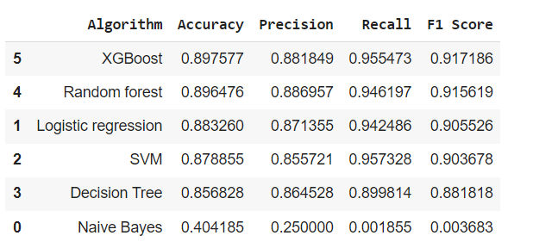
Predictive Analytics for Student Retention in Higher Education in Portugal
Govinda Rajulu Edeti
Pace University
Logo
GitHub: https://github.com/govindarajulu0555/CS668CapstoneProject
Abstract
Dataset
Results
Conclusions
Student retention is a crucial challenge faced by higher education institutions globally, including those in Portugal. This study addresses the critical importance of this issue by leveraging predictive analytics to develop proactive strategies for enhancing student retention in Portuguese higher education. Existing literature reveals significant gaps in the utilization of advanced predictive analytics specifically tailored to the Portuguese higher education context. This research identifies these gaps and proposes a novel solution approach that integrates comprehensive data analysis, machine learning algorithms, and statistical models.
The proposed approach encompasses an in-depth analysis of multifaceted student data, including demographics, academic performance, socio-economic factors, and engagement indicators. By harnessing this diverse dataset, predictive models will be constructed to identify at-risk students and recommend personalized intervention strategies. The novelty lies in the contextualization of predictive analytics techniques within the Portuguese higher education system, catering to its unique socio-cultural and institutional aspects.
A robust evaluation framework will validate the efficacy of the proposed solution. The evaluation process involves rigorous testing and validation of predictive models using historical data, followed by a prospective assessment to gauge the effectiveness of the recommended intervention strategies. The soundness of the evaluation methodology ensures the reliability and applicability of the proposed solution within the Portuguese higher education landscape.
The primary contribution of this research lies in its tailored application of predictive analytics to address student retention challenges in Portuguese higher education. By bridging the identified gaps in related work, this study provides a novel framework that not only identifies at-risk students early but also offers actionable insights for institutions to intervene effectively. Ultimately, this research aims to empower educational stakeholders in Portugal with data-driven tools to bolster student retention and foster a more supportive and successful academic environment.
Research Question
Is it possible to identify at-risk students early in their academic journey using available enrollment data, with the aim of reducing dropout rates and enhancing graduation rates in higher education?
The dataset contains information related to various factors potentially affecting student retention in a higher education context in Portugal. It encompasses diverse categorical and numerical variables, such as application mode, course, previous qualification, gender, scholarship status, age at enrollment, and academic performance indicators in the first and second semesters. Additionally, it includes economic indicators like unemployment rate, inflation rate, and GDP. The dataset focuses on key attributes relevant to student retention, including enrollment details, academic progress, and socio-economic factors. The 'Target' column likely represents the outcome variable indicating whether a student retained or dropped out. The dataset comprises 4424 instances and is primarily filtered to include columns pertinent for modeling, highlighting features thought to have significant predictive value for student retention analysis.
The predictive models for student retention in Portuguese higher education revealed that XGBoost and Random Forest outperformed other algorithms, showcasing superior predictive capabilities across various metrics. While Logistic Regression, SVM, and Decision Tree demonstrated reasonable performance, Gaussian Naive Bayes displayed limited effectiveness. These results suggest that XGBoost and Random Forest could be valuable for informing intervention strategies, but further feature analysis, model refinement, and ethical considerations are necessary before deployment in real-world educational settings. Continued model evaluation and iterative improvement remain essential for maximizing the models' relevance and effectiveness in supporting student success and retention efforts.
In this study, the utilization of essential student-related features and diverse machine learning algorithms revealed valuable insights into predicting student retention in Portuguese higher education. Results underscored the efficacy of ensemble methods, particularly XGBoost and Random Forest, which showcased superior accuracy in identifying at-risk students. While Logistic Regression and SVM displayed competence, Naive Bayes exhibited limitations in capturing complex dependencies among features. To optimize predictive capabilities, further exploration into feature engineering and model refinement, especially for Decision Tree, is recommended. The study highlights the promise of employing ensemble methods like XGBoost and Random Forest for early identification of at-risk students, presenting opportunities for educational institutions to implement proactive interventions and improve student outcomes.
Future Work
Future work in this domain could involve augmenting datasets with diverse sources, including socio-economic and psychological factors, to enhance model performance. Continuous refinement of feature selection methods, addressing imbalanced data issues, and exploring longitudinal studies for temporal analysis can further improve predictive accuracy. Efforts to enhance model interpretability, validate models across various contexts, establish ethical guidelines, and assess real-world impact through pilot deployments are crucial steps towards developing more robust, ethical, and applicable predictive models for student retention in higher education.
Methodology
Utilized a variety of machine learning algorithms such as XGBoost, Random Forest, Logistic Regression, SVM, Decision Tree, and Naive Bayes enables the assessment of predictive performance across different methodologies. And used the performance metrics(Accuracy, Precision, Recall, F1 Score) to evaluate model. These metrics suggest that XGBoost and Random Forest outperform other models, exhibiting higher accuracy and balanced precision-recall trade-offs. Logistic Regression and SVM also show competence but with slightly lower accuracy. The methodology serves as a robust framework for exploring and identifying the most effective predictive models for student retention in higher education in Portugal, providing valuable insights for decision-making and intervention strategies.
References
B. Kiss, M. Nagy, R. Molontay and B. Csabay, "Predicting Dropout Using High School and First-semester Academic Achievement Measures," 2019 17th International Conference on Emerging eLearning Technologies and Applications (ICETA), Starý Smokovec, Slovakia, 2019, pp. 383-389, doi: 10
Respondek L, Seufert T, Stupnisky R and Nett UE (2017) Perceived Academic Control and Academic Emotions Predict Undergraduate University Student Success: Examining Effects on Dropout Intention and Achievement. Front. Psychol. 8:243. doi: 10.3389/fpsyg.2017.00243.1109/ICETA48886.2019.9040158.

